Slide 1

Healthy day for you
TEAM: Data revolvers
SUMIT DESHMUKH, MAANSI CHANDIRA, LEANDRA MENEZES, VIPRA SHAH
TA: ABHIJEET PATIL

Slide 2
Over 21 million people of the population are suffering from diabetes in USA alone.
More than 8 million people have diabetes, yet unaware about it.
Common symptoms of diabetes: Cuts/bruises that are slow to heal, Feeling very hungry - even though you are eating.
Current diagnosing technique involves invasive blood tests such as
1) Random blood sugar test and
2) Fasting blood sugar test.
Necessity of non-invasive technique to continuously monitor glucose is the need of the hour
FitDay foresees that fitness tracker devices will include biosensors to monitor a Diabetic patient in the near future
Having glucose information as easy as heart rate or calories burned will be vital to live a healthy life

Slide 3

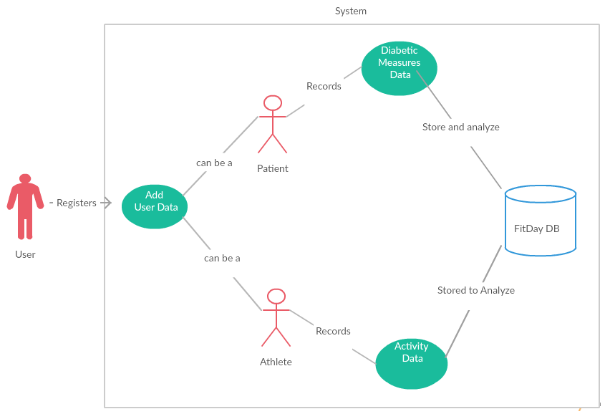
User Role
User registers himself in the FitDay system as Athlete and/or Patient.
The system stores diabetic measures or activity data from user’s device.
Analysis of User Data is done and appropriate suggestions are made.

Slide 4
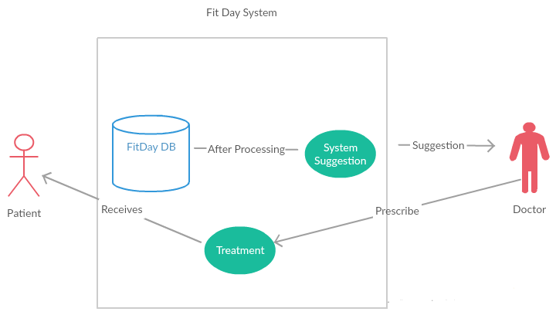
Doctor and Patient
FitDay system after processing diabetic measures of each patient provides suggestion to doctor
Doctor refers to the system suggestion and prescribes treatment to the patient

Slide 5

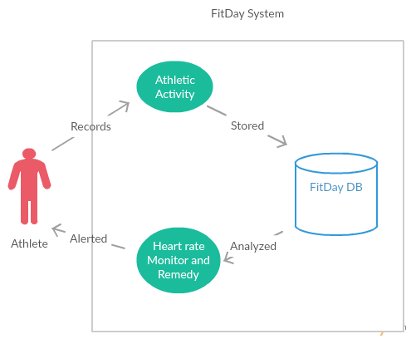
Athlete
Athlete activity and vital signs are recorded in the system and stored in the FitDay database for analysis.
The system analyzes heart rate and suggests remedies to the athlete
Calories burned during the activities are also stored for each athlete

Slide 6

Normalized databases fair very well under conditions where the applications are write-intensive and the write-load is more than the read-load.
Main cause of concern with fully normalized tables is that normalized data means joins between tables.
Joining means that read operations have to suffer because indexing strategies do not go well with table joins.

Slide 7
Denormalized databases fair well under heavy read-load and when the application is read intensive.
The data is present in the same table so there is no need for any joins, hence the selects are very fast.
A single table with all the required data allows much more efficient index usage.
Selects can be very fast on denormalized tables, but because the data is duplicated, the updates and inserts become complex and costly
Denormalized schema greatly improves performance with efficient use of triggers.

Slide 8


Neither of the approach can be entirely neglected, because a real world application is going to have both read-loads and write-loads.
Hence the correct way would be to utilize both the normalized and denormalized approaches depending on situations.

Slide 9

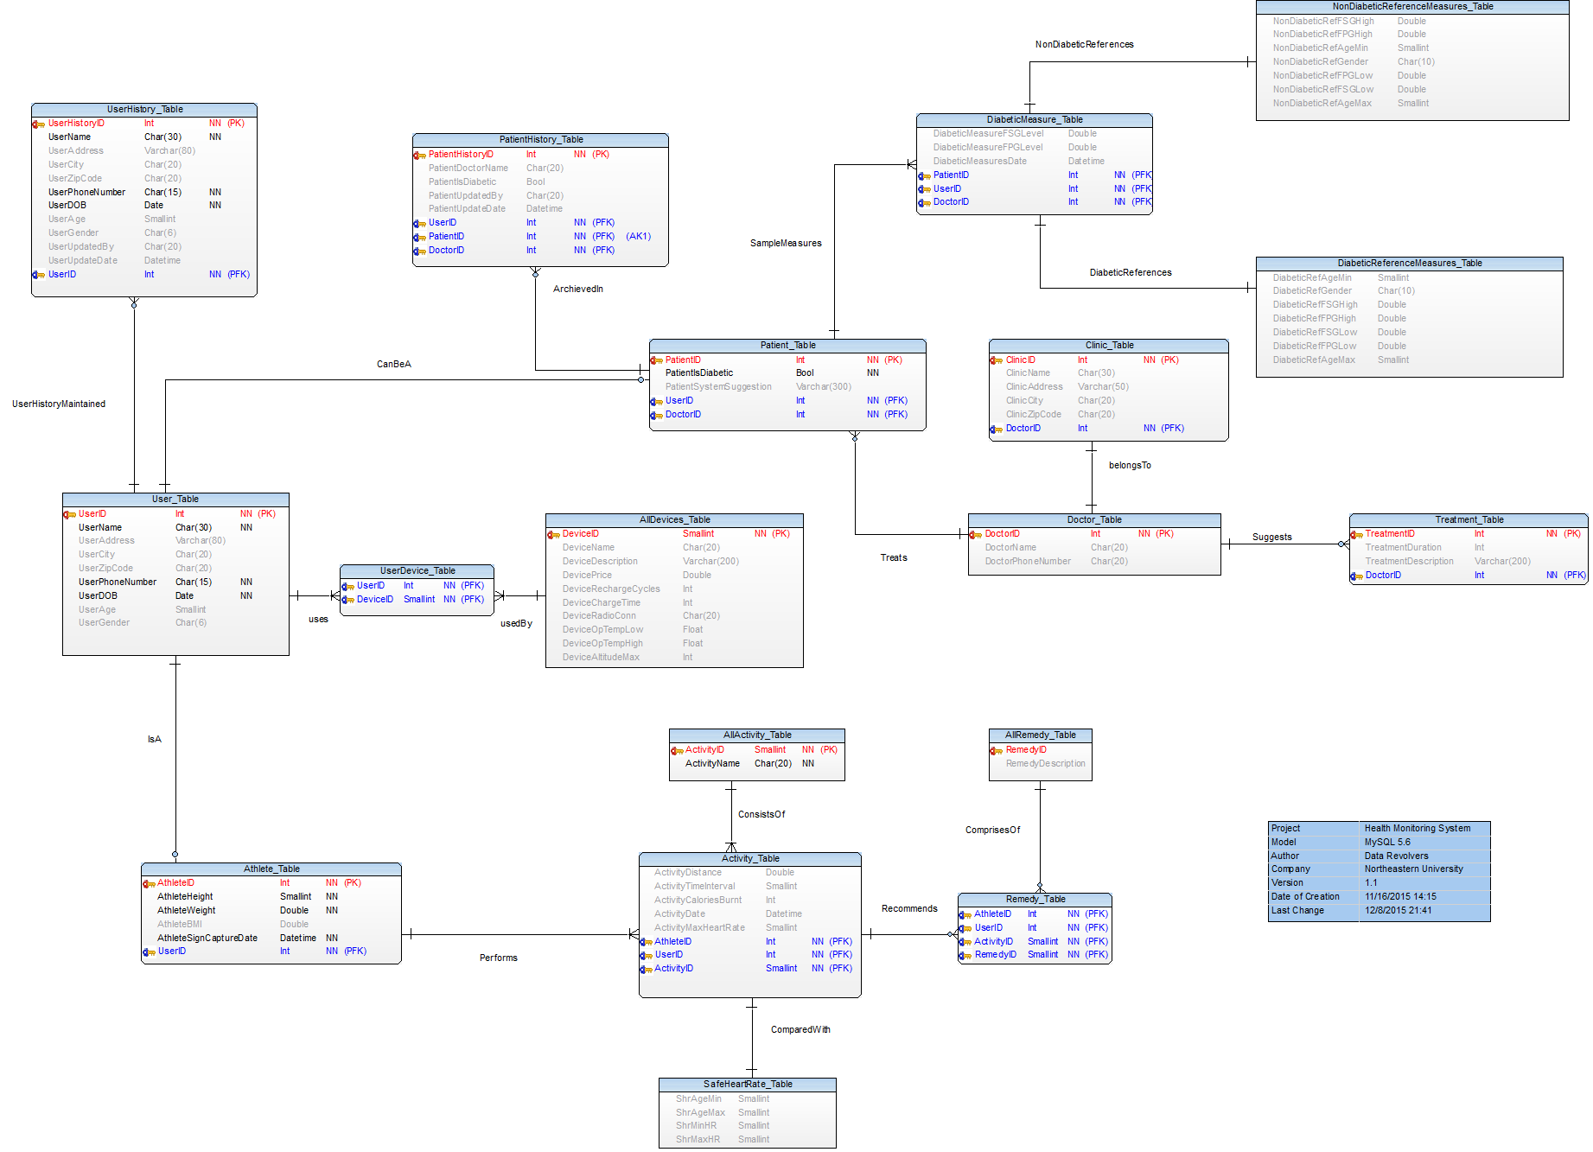

Slide 10
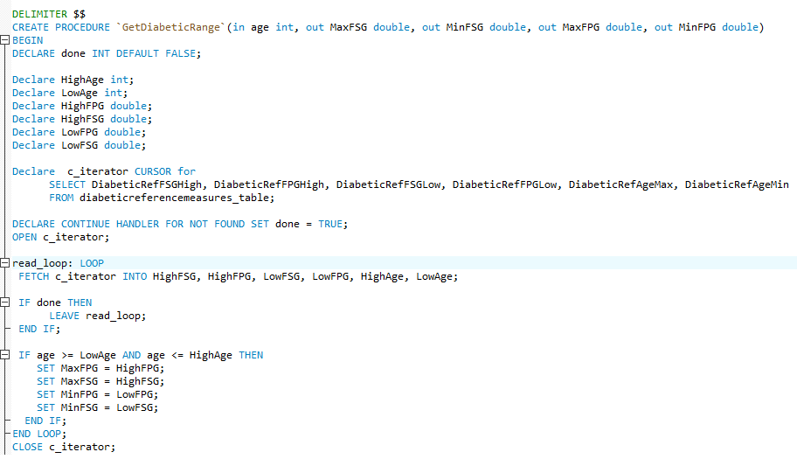
Get Diabetic Range for particular age group

Slide 11
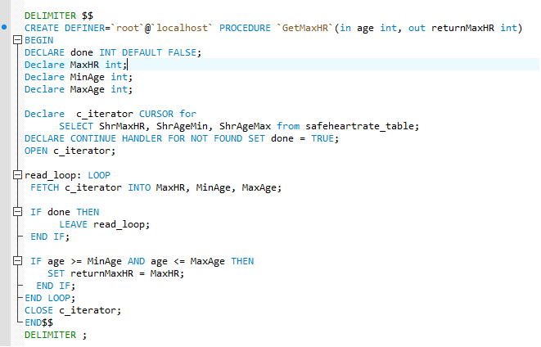
Procedures
Get Maximum Safe Heart Rate for given age group

Slide 12
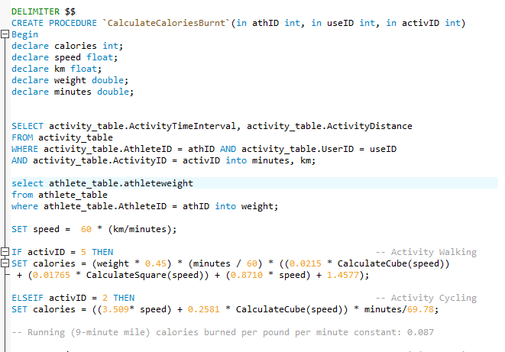
Procedures
Get Calories burned for an Athlete in given Activity

Slide 13
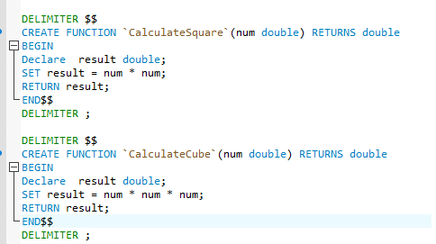
Functions
Functions to facilitate Calories Burned calculation
Unlike procedures functions can return only single value

Slide 14
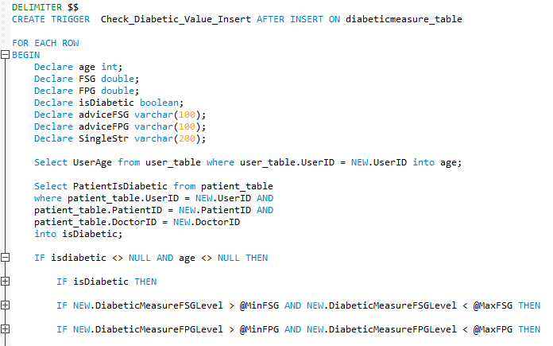
Triggers
Insert Trigger to suggest doctor the Level of FSG & FPG in a patient

Slide 15
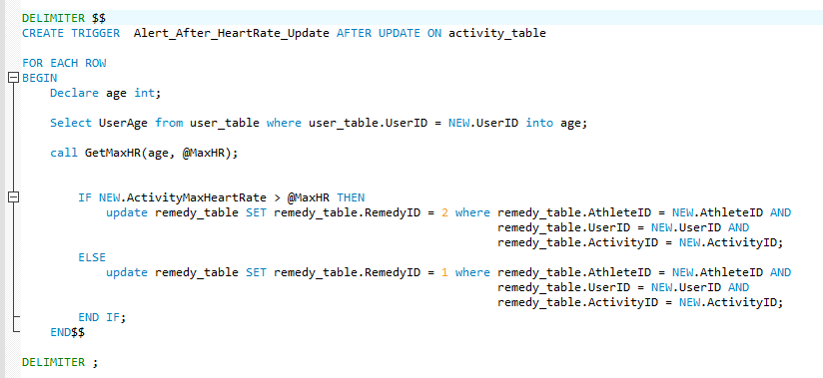
Triggers
Update Trigger to suggest Athlete the Remedy after a given activity

Slide 16
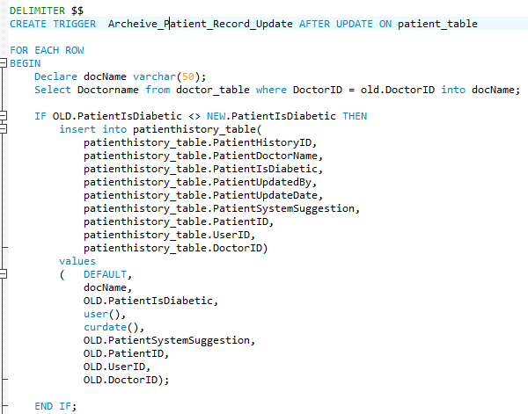
Triggers
Trigger to archive patient data when patient’s diabetic state is changed

Slide 17
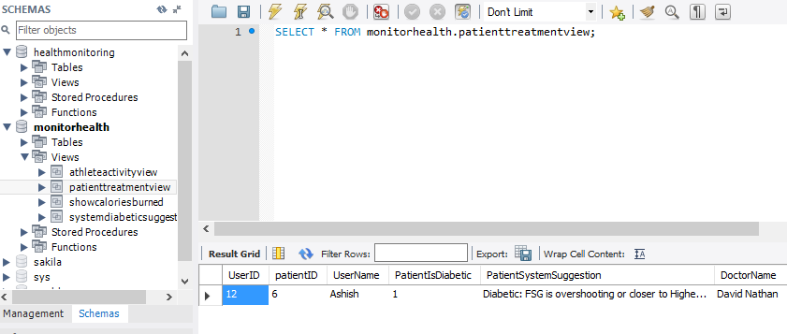
Views

Slide 18
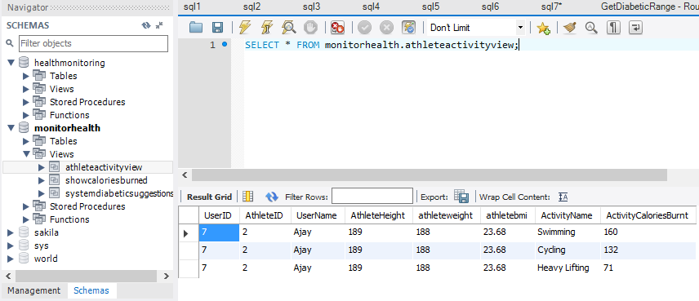
Views

Slide 19


An index is used to speed up the performance of queries.
It does this by reducing the number of database data pages that have to be visited/scanned.
In MySQL InnoDB, a clustered index determines the physical order of data in a table.
There can be only one clustered index per table (the clustered index IS the table)

Slide 20
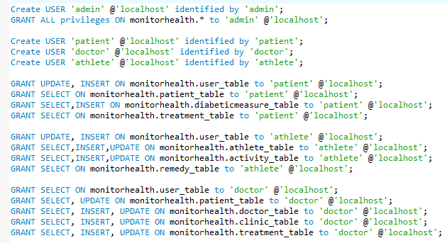
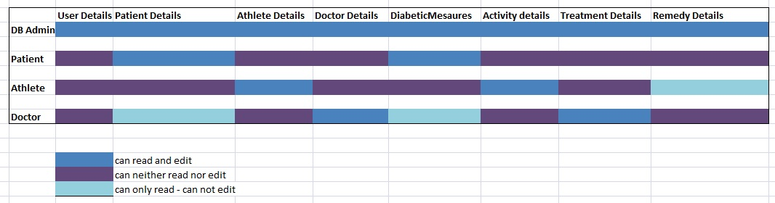

Slide 21

Using Triggers,
Functions,
Procedures
Applying Normalization and
De-normalization techniques
Indexing we can retrieve data fast and maintain data easily

Slide 22

Can be modified to add animals
System can be altered to cover other non invasive techniques
Can include more activities like horse-riding , skipping, spinning, dancing etc.
Logging meal intake
Calorie intake record

Slide 23

Noninvasive Method for Glucose Level Estimation by Saliva
Agrawal RP1*, Sharma N2, Rathore MS2, Gupta VB2, Jain S1, Agarwal V1 and Goyal S1
2014 diabetes statistics report-CDC
Diabetes.org journal
Walking Calorie Burn Formula
glucose levels in normal people and in diabetic patients
D. K. Sen And G. S. Sarin

Slide 24

Prof. Chaiyaporn Mutsalklisana
TA’s: Abhijeet Patil

Slide 25


